Slide 1
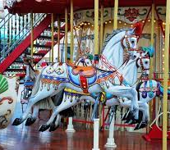
Carousel: Speaking activity

Slide 2
Instructions:
Each person will receive a question.
Ask the person opposite you the question.
You then answer their question.
When you are both finished please SWAP questions.
Then the people on the outside step to the right.
You now have a new partner to ask questions to.
Divide the class into two e.g. 14 total students- 2 groups of 7
7 people stand in a circle facing outward
7 other people stand opposite

Slide 3
Scaffolded language (support)
Repeat the question!
Why did I become a teacher? That’s hard to answer! I’m not sure to be honest… I …
Oh that’s a tricky question…I need a moment to think
Hmmm…well, I guess…
Oh that’s easy! I…
Well, if I’m really being honest, I’d have to say…
You know what I mean?
Hmmm, let me see…
To tell you the truth, I’ve never thought about that before!
I need a moment to think about that

